Slide 1
Training Distribution Preserving Variational Autoencoders using Synthetic Data
Synthetic Data Generation
Soham Palande, Yousef El-Laham

Slide 2

About Me
B.S. in Computer Science, Mathematics; Rutgers University
Prior Research:
Senior Thesis: Simulation Based Modelling for Optimizing Systems Under Uncertainty
Simulating Quantum Circuits via Bayesian Networks
L3Harris: Autoencoders for Anomaly Detection of Vessels in High-Risk Sea Regions
Currently:
Synthetic Data Generation at J.P. Morgan AI Research
Time-Series Data

Slide 3
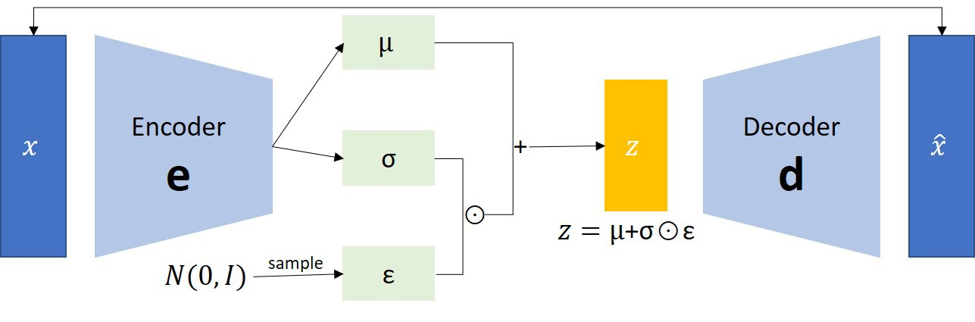

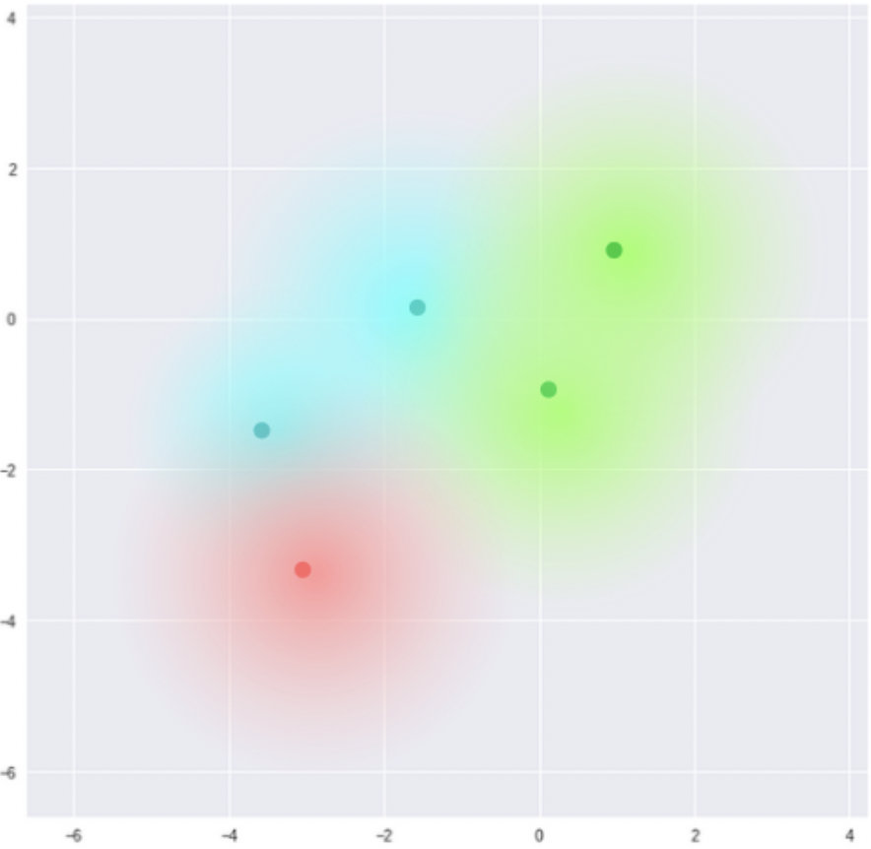
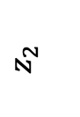
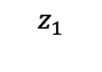
Variational Autoencoders (VAEs)
Samples are encoded as Gaussian random variables in a lower-dimensional latent space
How do we aggregate VAE models that are trained on different datasets?
$$z_{2}$$
$$z_{1}$$

Slide 4



Generative Models: One vs. Many
1
1*
1*
2
2*
2*
2
3*
3
3*
In principle, one can train a generative model for each of the datasets and then ensemble at test time
Why do we want to avoid doing that?
Memory efficiency (model compression); joint model has the same size
Use of latent space in downstream tasks (e.g., anomaly detection, transition between distributions)

Slide 5




Case 1: Decentralized Workflows
*Federated Learning*
Notes:
Similar to previous setting- how do we do it in a way that retains the individual qualities of each of the datasets?
Precursor to federated learning
Federated learning: is a machine learning technique that trains an algorithm across multiple decentralized edge devices or servers holding local data samples, without exchanging them
Centralized vs. Decentralized Federated Learning

Slide 6

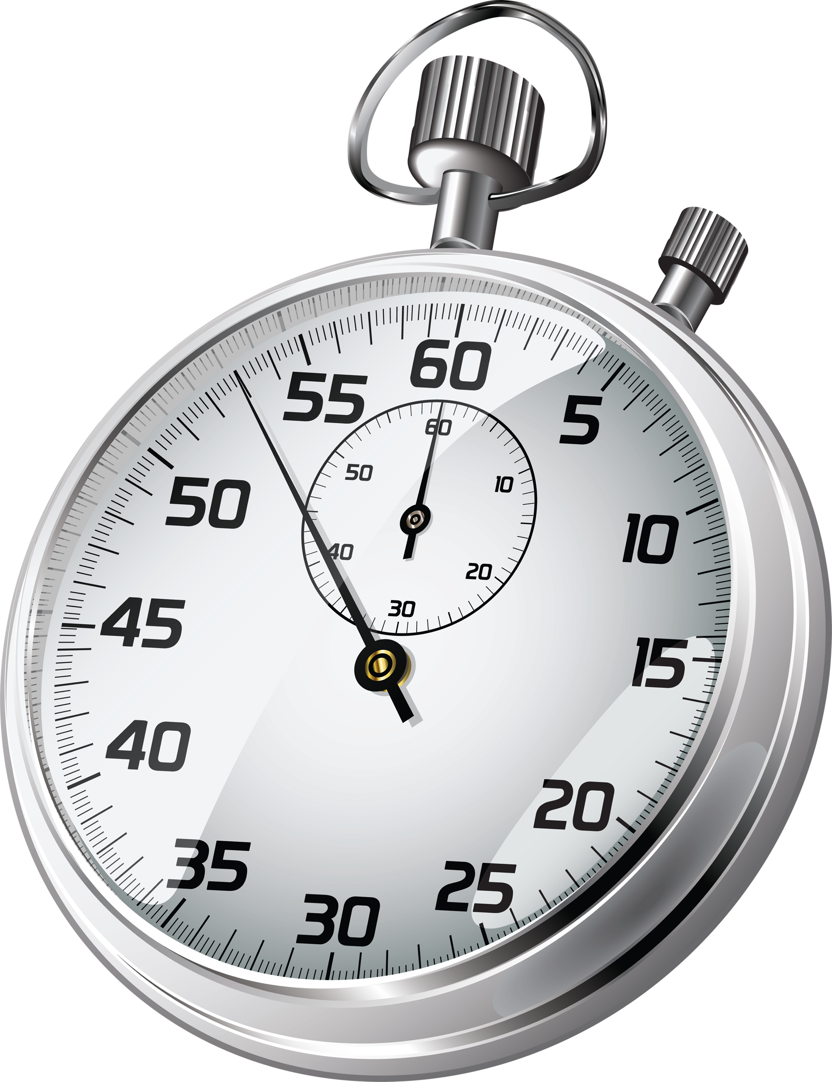

Case 2: Online Learning
1
1
1*
1
2
2*
2
n
n*
n
Notes:
Wikipedia definition: online learning + examples
Computationally expensive
May not have access to all data/inefficient to store- private data (medical data, or some other proprietary data) but want model to learn from all the data
Instead of retraining with larger and larger datasets, can we then just train models on the new data and combine them in some way that allows us to generate synthetic data from the combined larger dataset without having to retrain on the original data?
Short answer is yes! The models generate synthetic data- and so assuming that the models are well trained and effectively learn the underlying distribution of the data, we can just generate new training data sampled from the original distribution- and potentiall have smaller datasets that more efficiently capture and represent the underlying distribution
But at what cost? Synthetic data may have some noise- lower fidelity- especially in challenging domains such as time-series.
That is what we aim to define and address in this project
Problem of combining two models

Slide 7
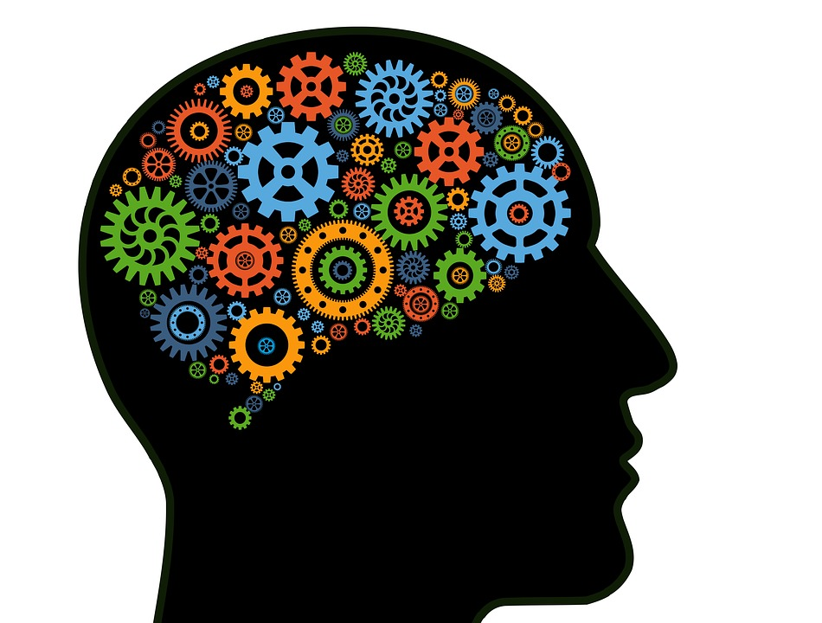
Business Application
Focus Area: Synthetic Time Series Data Generation
Why?
QR/Traders
Market Data:
Non-stationary time series (similar but distinct distributions)
DL models are designed to operate in stationary environments
need to update trading models frequently with each market regime shift; want robust models
Limited data:
real-time generation (SLOW!)
Low signal-noise ratio
need lots of data for robust DL models; more data corresponding to current regime; synthetic data augmentation
Online/Decentralized learning: reuse synthetic data gen model trained on previous data (market regimes) for robustness; learn from other proprietary datasets
AIRSyn: Does not yet have synthetic time series generation capabilities
Notes:
Motivate it from why do they even need synthetic data to how they can benefit from this online learning/decentralized learning approaches
Other research areas: using DGMs to amplify signals mitigate noise, potentially to detect these distribution shifts in time series data, make predictions in the latent space which has stronger statistical properties – maybe good for downstream tasks

Slide 8
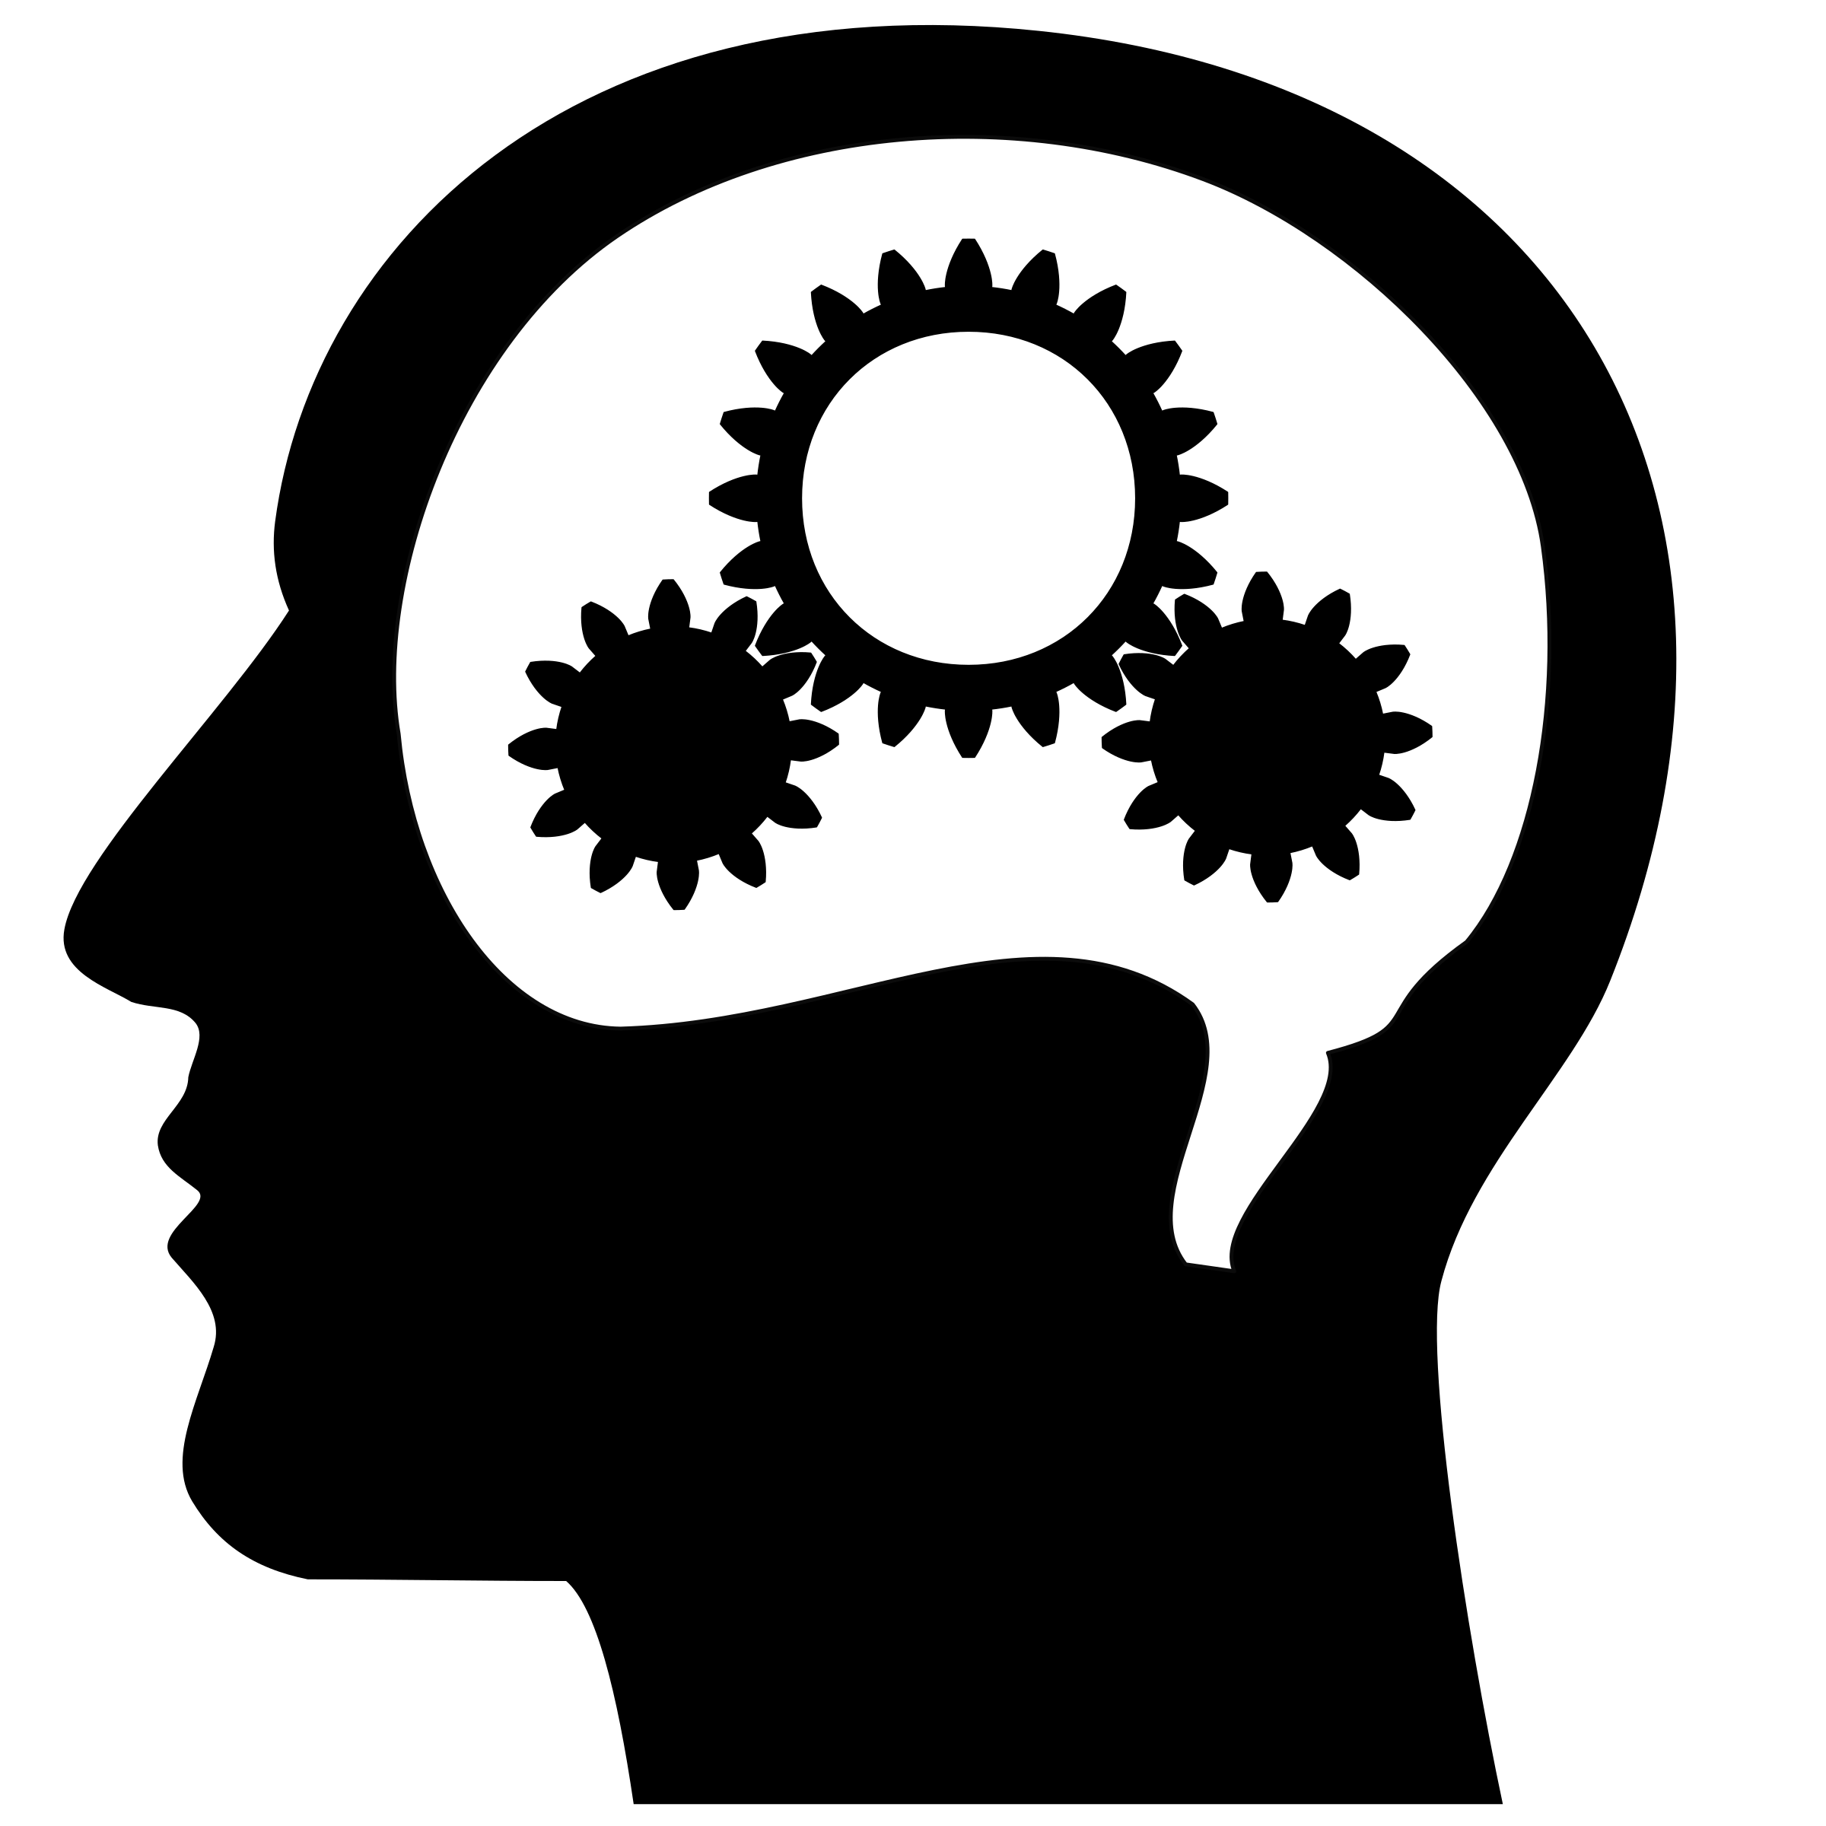
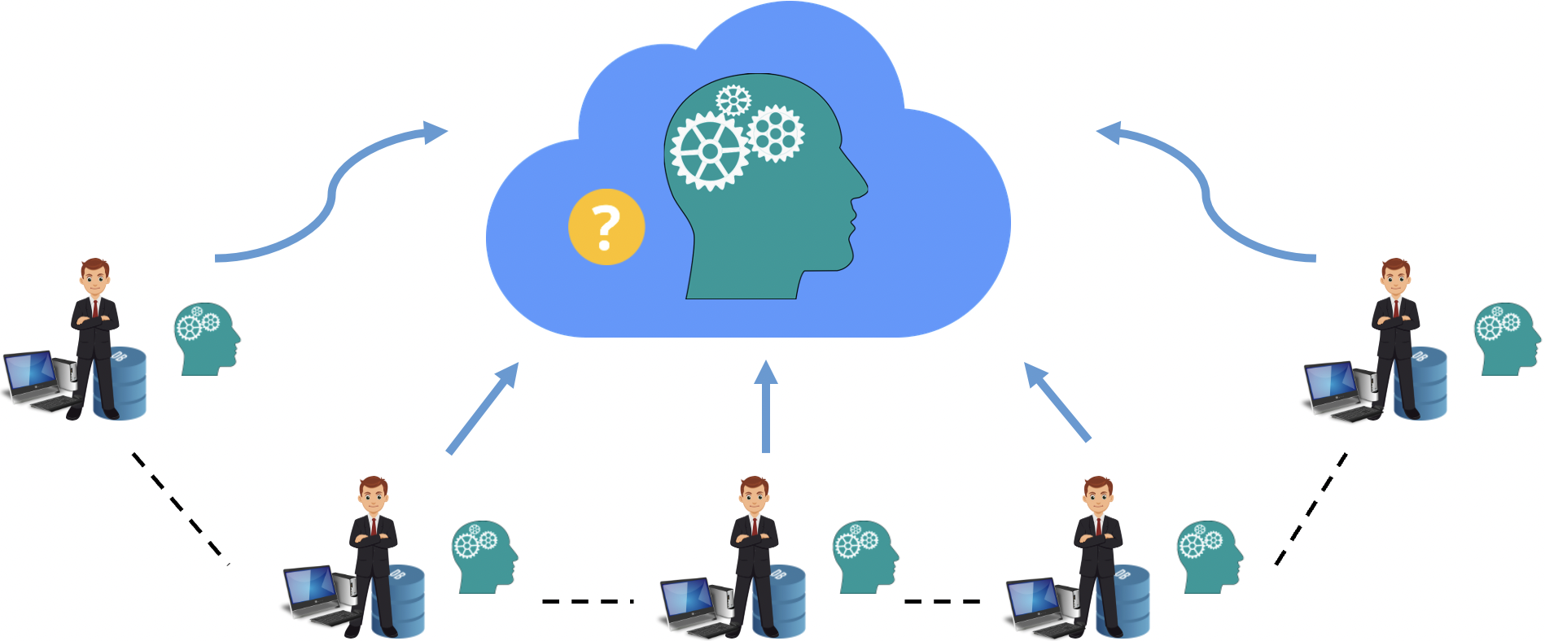
Goal: Robust Models
Why retrain with larger datasets?
Robust, expressive models
Online Learning:
The data becomes available in a sequential order (ex: market data) and is used to update the model for data generation at each step;
want model to dynamically adapt to new patterns in data
Decentralized Workflows: want to build robust models through training on distinct distributions while maintaining privacy
Online Learning
Decentralized Workflow

Slide 9
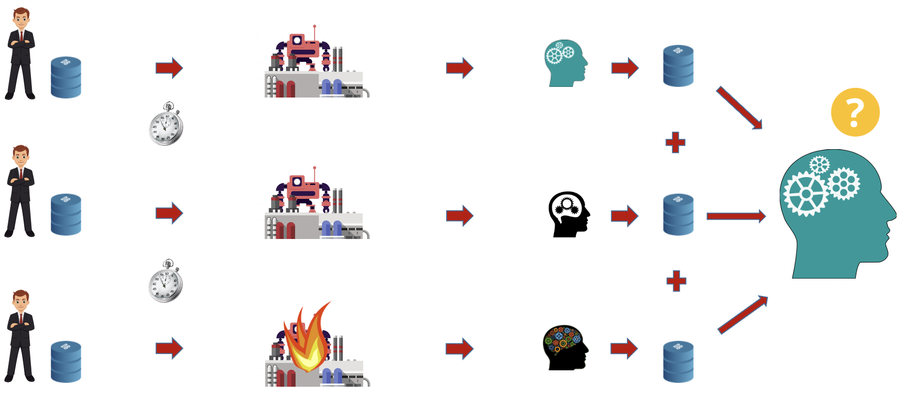
Problem: Large Datasets + Privacy
Issues:
Dataset Access:
Users may not have indefinite access to the training data (ex: medical data, proprietary data)
Data may not be stored in the generating tool due to security concerns
Privacy: Users may want to learn from datasets from different distributions but not share the datasets
Similar Distributions: Training on datasets coming from similar but distinct distributions may impact model performance (ex 1s and 7s)
Training using Synthetic Data
Online Learning
Decentralized Workflow
Notes:
Model performance: could produce more overlap than we want

Slide 10
Research Objectives
How does training a VAE model with multiple synthetic datasets impact generative performance?
How do we preserve the latent space structure corresponding to each of the prior datasets when training VAEs?
Performance tradeoff of training on synthetic data vs. original data
Manifold regularization to preserve structure of latent space
Demonstrate generative performance when combining datasets having similar but distinct distributions with and without manifold regularization
Transfer learning vs. aggregated datasets
Manifold Regularization using synthetic data

Slide 11
Problem Statement
Can we train variational autoencoders on multiple datasets such that:
the resulting model more effectively preserves the distributional properties corresponding to each of the prior datasets?
By training on synthetic data, we address the issues of dataset access and privacy
How do we effectively preserve the distributional properties of the latent datasets?

Slide 12
Background and Methods

Slide 13
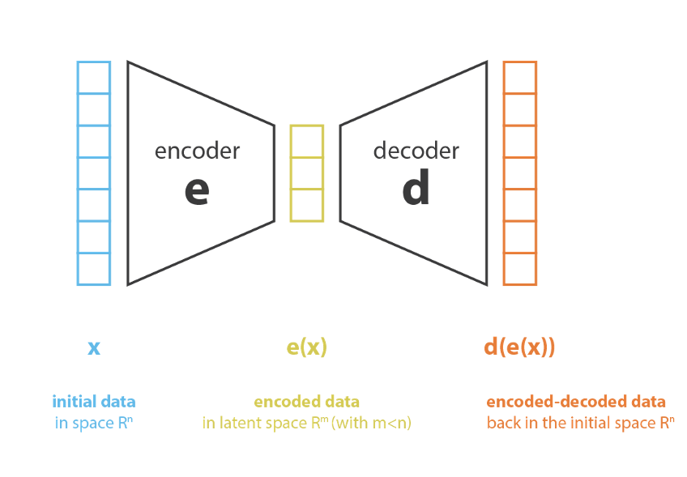
Deep Generative Models: VAE
Variational Autoencoders (VAEs) are probabilistic graphical models used to model the training data’s true distribution
VAE’s are comprised of an encoder-decoder architecture:
Encoder: Encodes the input to a lower dimensional vector in the latent space
Decoder: reconstructs the input from the regularized low dimensional latent space
The training for VAE is regularized to avoid overfitting and ensure that the latent space has good properties for data generation

Slide 14
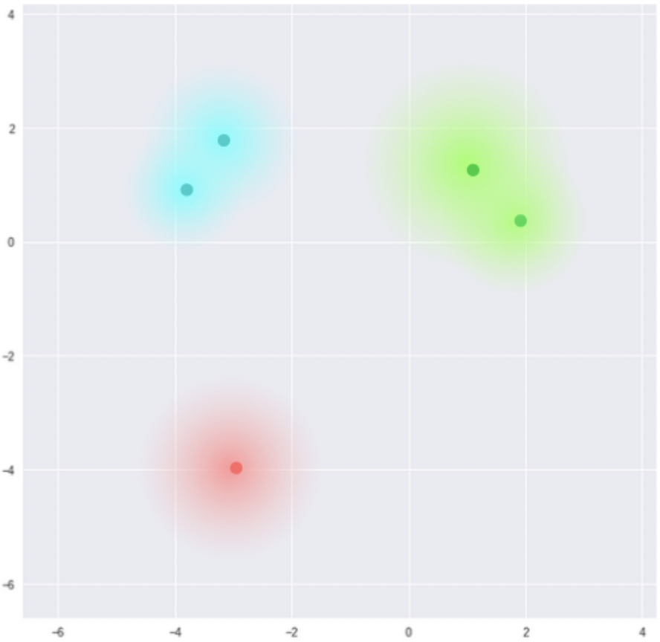
Deep Generative Models: VAE
Autoencoders: latent spaces which are not continuous and do not allow for easy extrapolation
New samples generated by sampling from the latent space may be meaningless
VAE: Regularization allows for construction of latent spaces which are continuous
The data is still clustered in correspondence to different classes, but the clusters are close to the center of the latent space
Latent Space of Autoencoders
Latent Space of VAE

Slide 15
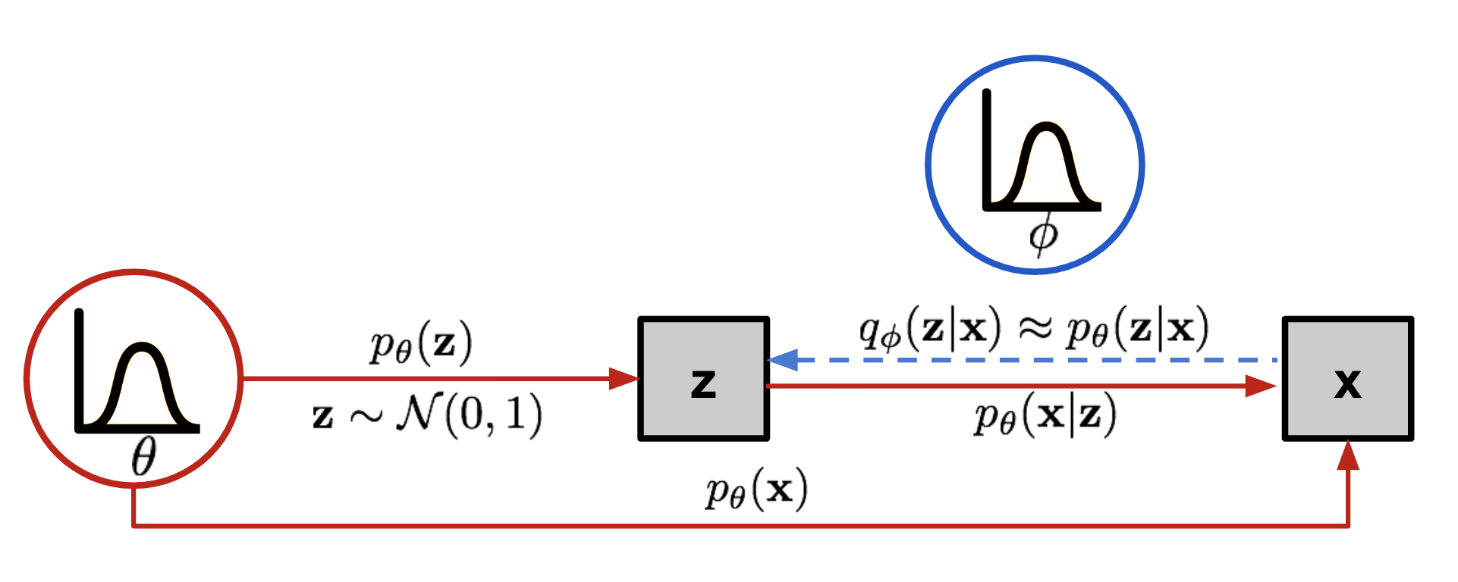
Deep Generative Models: VAE
We map the input 𝘹^{(i)} into a distribution 𝘱_{𝜃}
Prior: 𝘱_{𝜃}(𝘻)
Likelihood : 𝘱_{𝜃}(𝘹|𝘻)
Posterior: 𝘱_{𝜃}(𝘹|𝘻)

Slide 16
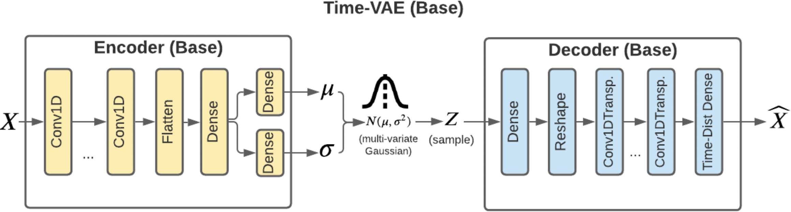
Deep Generative Models: TimeVAE
VAE model architecture for generating synthetic time-series data by Desai at al.
Bottleneck layer of VAE acts to denoise the data aiding in downstream tasks such as forecasting
Proposed Advantages:
Outperforms existing approaches when size of training data diminishes
Better performance on next-step prediction tasks
Planar Flow-Based VAE for time series generation: LSTMs (Jin et al. (2022))
Notes:
Discriminator Scores:

Slide 17
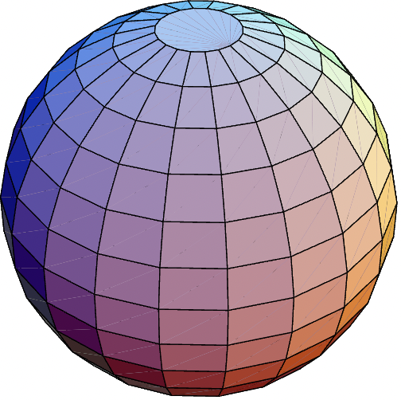
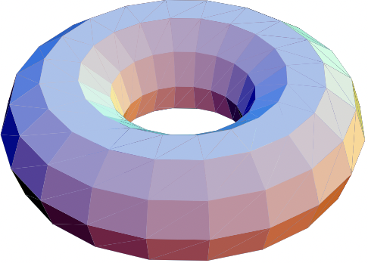
Mathematical Formulation
What is a manifold?
Topological space that locally represents a Euclidean space near each point (ex: 1d- lines, circles 2d- spheres, torus)
Manifold Hypothesis:
To learn anything from data, we assume that the data has some inherent structure
The observed data lie on a low-dimensional manifold embedded in a higher dimensional space
Sphere
Torus
Notes:
Also known as the manifold assumption
I’m not being very formal here: my goal is to give you a really nice intuition of what we’re trying to accomplish here

Slide 18
Mathematical Formulation
(ℳ, 𝑔) is a Riemannian (smooth) manifold of dimension 𝑛
𝑓: ℳ ➝ ℝ on (ℳ, 𝑔)
What does it mean for 𝑓 to be smooth at a point 𝑥∈ ℳ?
Intuitively, 𝑓 is smooth if its value at a point is similar its value at each of the points neighbors i.e. the rate of change (derivative) at x has a small magnitude
So, we can define smoothness at x as: ∥∇𝑓(𝑥)∥²
We can define the smoothness of 𝑓 on ℳ as: ∫_{ℳ} ∥∇𝑓(𝑥)∥² 𝑑𝑥 (Dirichlet Energy)
Smaller value indicates a ‘smoother’ function on ℳ
Notes:
(M, g)- g is a map that assigns to each x in M an inner product on the tangent space T_xM at x.
∥∇𝑓∥² is the norm of the derivative of f at x squared
Why squaring the norm of derivative????

Slide 19
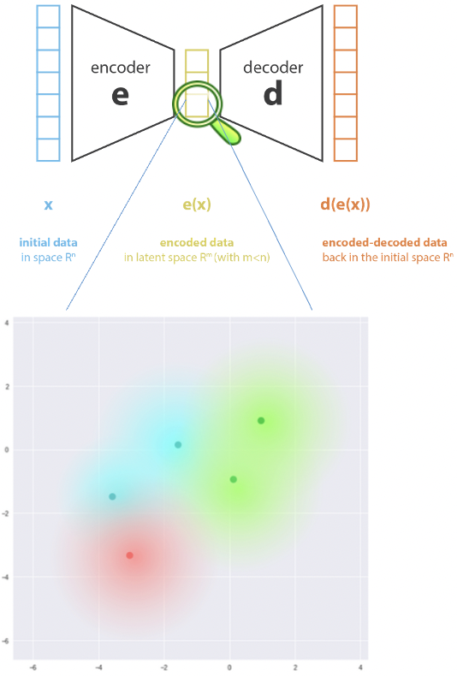

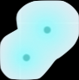
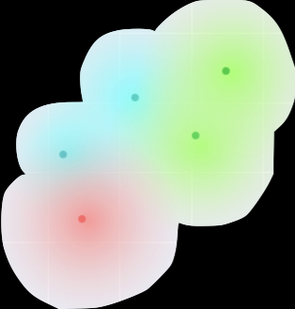
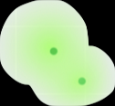
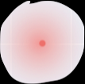



Visual Motivation
1
1
1
2
2
1
1
2
2
Verifiable
Manifold Regularization
Notes:
Preserve what we have learnt from previous models as it is and then combine the two models for a more robust powerful representation
Can be done for n number of models
Really preserve model individuality
Think of each model representing its own market regime

Slide 20
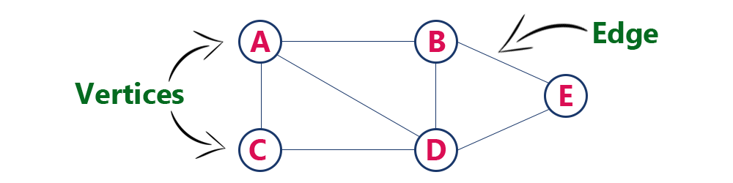

Mathematical Formulation
𝒢 = (V, E) is a graph; 𝑓: V ➝ ℝ on 𝒢
What does it mean for 𝑓 to be smooth on a graph G?
Smoothness: ∑_{(i,j)∈ E} (𝑓(i) - 𝑓(j))²
It is well known [3] that the Dirichlet energy can be approximated as:
∫_{ℳ} ∥∇𝑓(𝑥)∥² 𝑑𝑥 ≈ ∑_{(i,j)∈ E} (𝑓(i) - 𝑓(j))²
Graphs are discrete versions of manifolds
Manifold Regularization:
VAE Loss: (𝑥^{i} - 𝑥̂^{i})² + KL Loss + 𝜆[∑_{j∈ E} (𝑒(𝑥^{i}) - 𝑒(𝑥^{j}))²]
_{i}
Reconstruction error
Manifold Regularization
Divergence loss
Notes:
Graphs are discrete versions of manifolds!
Intuitively, 𝑓 is smooth if its value at a node is similar its value at each of the node’s neighbors
So, we can define smoothness using

Slide 21
Experiments and Evaluation

Slide 22

Experimental Setup
Step 1: Train Disjoint Models: Train VAE models on two datasets from different distributions
A
B
Step 4: Proposed Model: Train VAE on synthetic data with manifold regularization
Step 2: Target Performance: Train oracle VAE model on combined original datasets
Goal: Evaluate the performance of manifold regularization during VAE training with synthetic data
B+A
A+B
Step 3: Baseline: Train original VAE on new data (transfer learning)
A->B
B->A
Notes:
Goal: Evaluate the performance of manifold regularization during VAE training
Motivate step 3: Train original VAE with synthetic data vs training new model on synthetic data generated from both models

Slide 23
Experimental Setup
Experiment 1: Train Individual Models
Experiment 2: Train on Joint Datasets
Experiment 3: Transfer Learning
Experiment 4: Manifold Regularization: Joint Data
2
1*
2*
1
1*
2
2*
1
Notes:
Goal: Evaluate the performance of manifold regularization during VAE training
Motivate step 3: Train original VAE with synthetic data vs training new model on synthetic data generated from both models

Slide 24
Results

Slide 25
Experiment 1: MNIST

Slide 26
Experiment 1
Experiment 1: Train Individual Models
1
1*
2
2*
Notes:
Goal: Evaluate the performance of manifold regularization during VAE training
Motivate step 3: Train original VAE with synthetic data vs training new model on synthetic data generated from both models

Slide 27
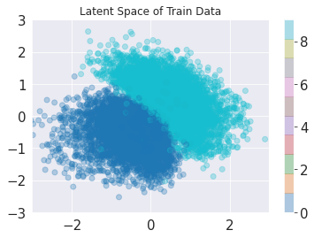
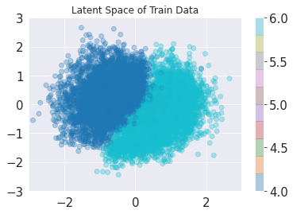
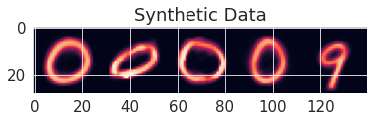
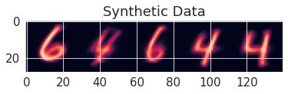
Experiment: Individual Models
Model 1
Model 2

Slide 28
Experiment 2
Experiment 1: Train Individual Models
Experiment 2: Train on Joint Datasets
1
1*
2
2*
Notes:
Goal: Evaluate the performance of manifold regularization during VAE training
Motivate step 3: Train original VAE with synthetic data vs training new model on synthetic data generated from both models

Slide 29
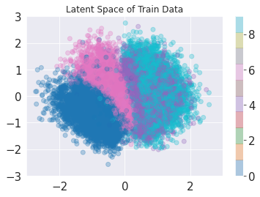
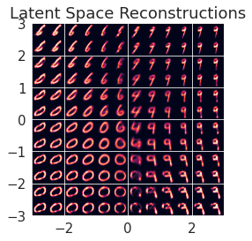
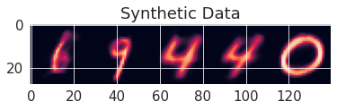
Experiment: Oracle Model
Latent Space Reconstructions

Slide 30
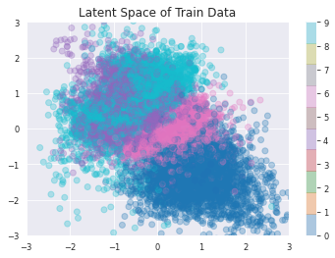
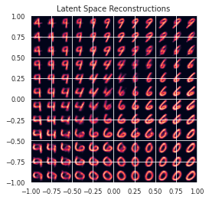
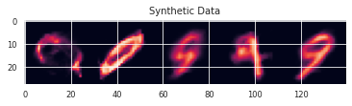
Experiment: Synthetic Data Model

Slide 31
Experiment 3
Experiment 1: Train Individual Models
Experiment 2: Train on Joint Datasets
Experiment 3: Transfer Learning
2
1
1*
2
2*
1
Notes:
Goal: Evaluate the performance of manifold regularization during VAE training
Motivate step 3: Train original VAE with synthetic data vs training new model on synthetic data generated from both models

Slide 32
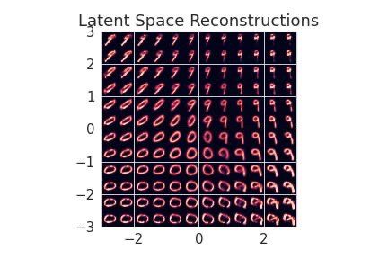
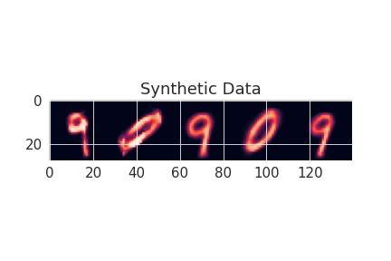
Experiment: Transfer Learning (Baseline)

Slide 33
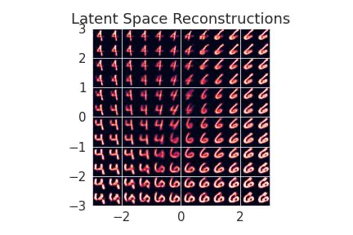
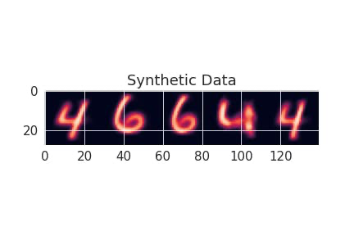
Experiment: Transfer Learning (Baseline)

Slide 34
Experiment 4
Experiment 1: Train Individual Models
Experiment 2: Train on Joint Datasets
Experiment 3: Transfer Learning
Experiment 4: Manifold Regularization: Joint Data
2
1*
2*
1
1*
2
2*
1
Notes:
Goal: Evaluate the performance of manifold regularization during VAE training
Motivate step 3: Train original VAE with synthetic data vs training new model on synthetic data generated from both models

Slide 35
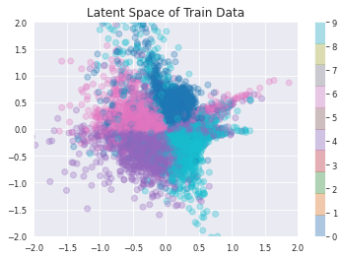
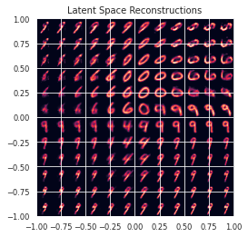
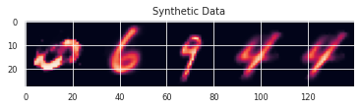
Experiment 4: Manifold Regularization

Slide 36
Latent Space Comparison
Original Datasets
Synthetic Datasets
Synthetic Datasets with Manifold Regularization

Slide 37
Experiment 2: Stock Prices

Slide 38
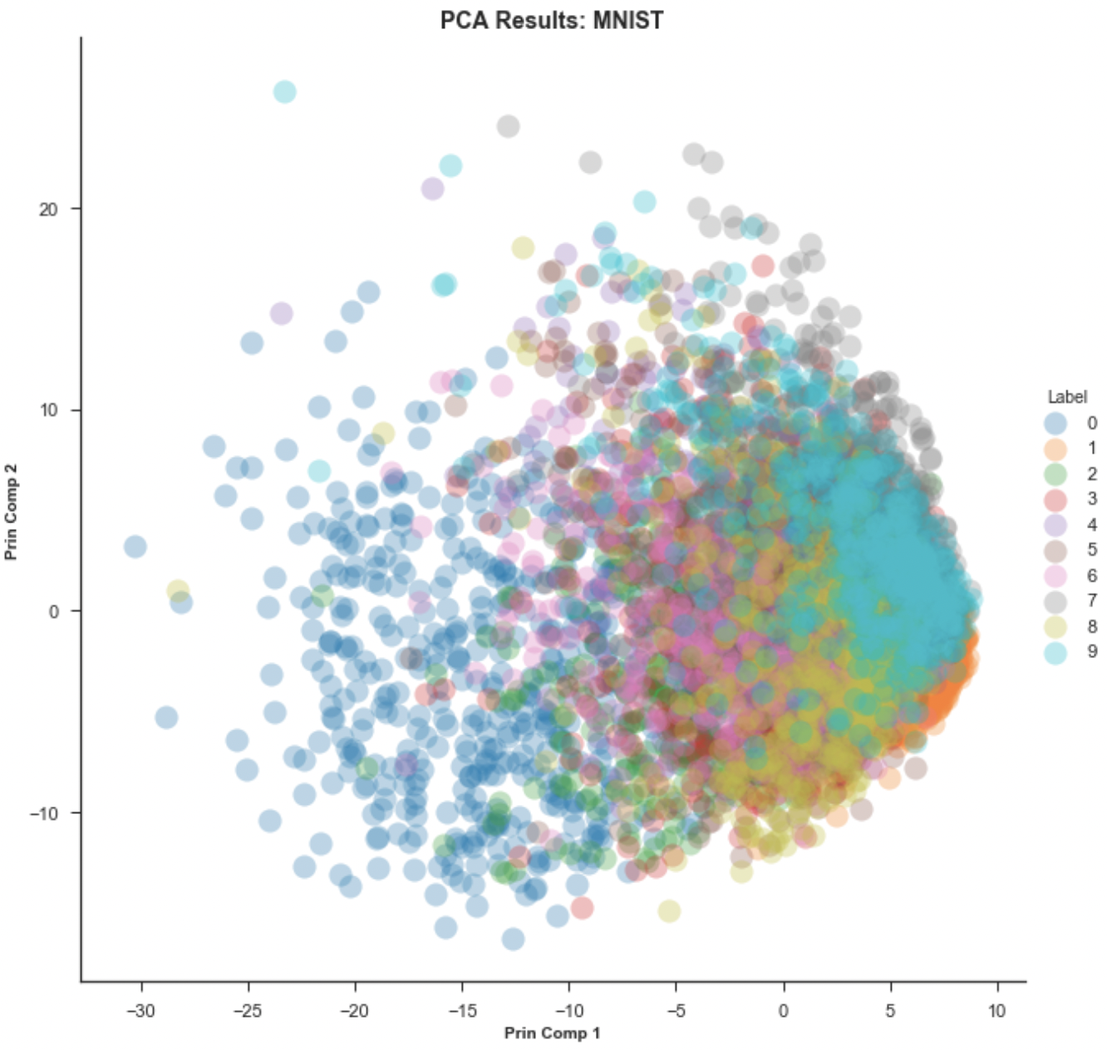
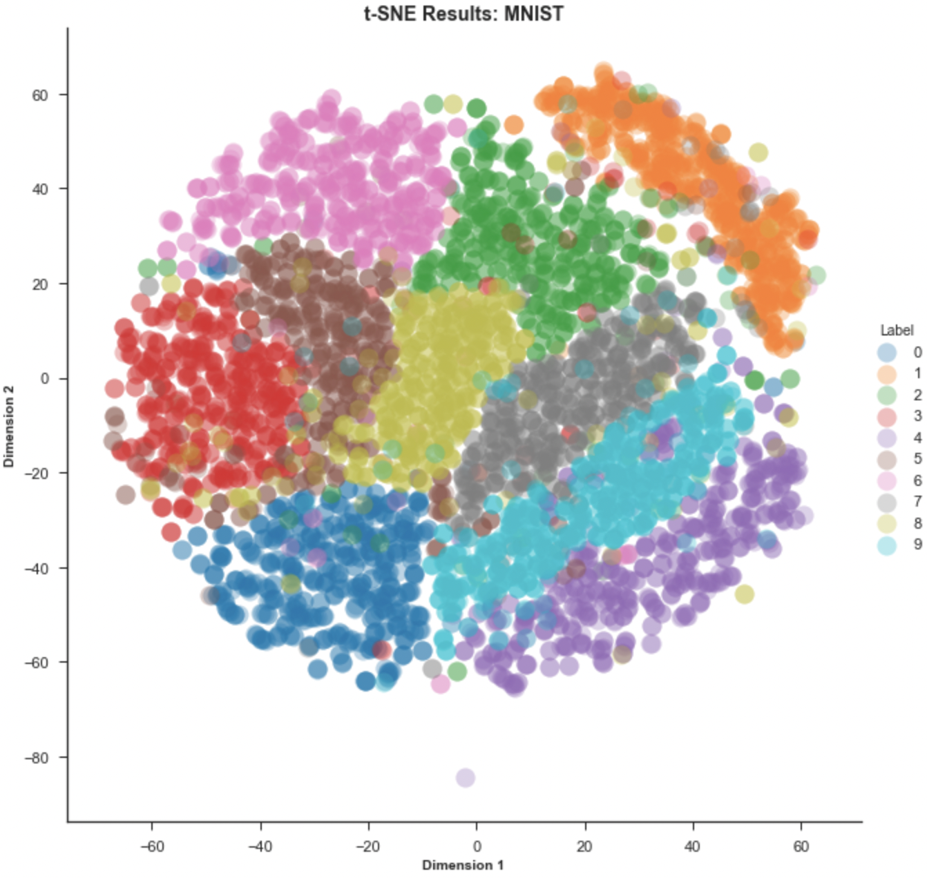
Evaluation Metric: t-SNE
t-Distributed Stochastic Neighbor Embedding (TSNE) (2008)
TSNE is an unsupervised, non-linear dimension reduction technique used to visualize high-dimensional data
Simply put, t-SNE gives us an intuition of how the data is arranged in a high dimensional space
PCA: PCA is a linear dimension reduction technique
Not suitable for dealing with non-linear manifold structures
PCA Results: MNIST
t-SNE Results: MNIST
Notes:
Goal: Evaluate the performance of manifold regularization during VAE training

Slide 39
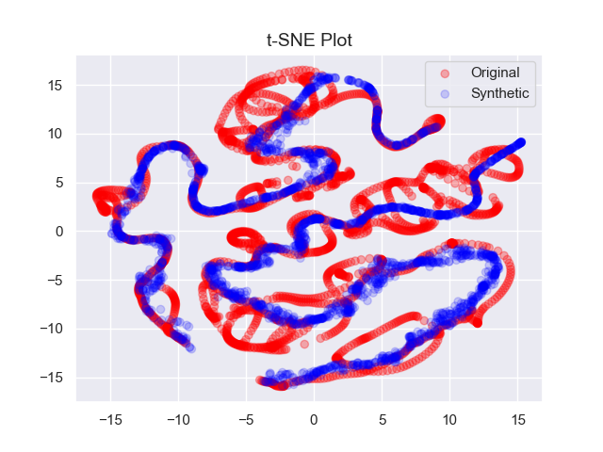
Experiment: Single Stock (AMZN)

Slide 40
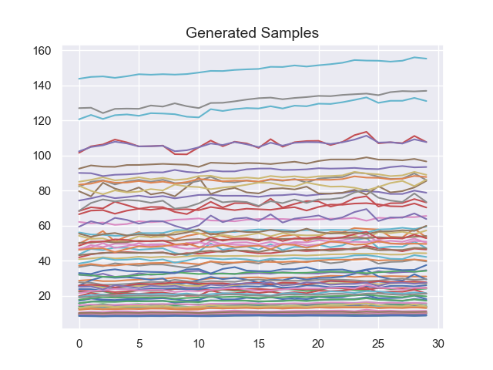
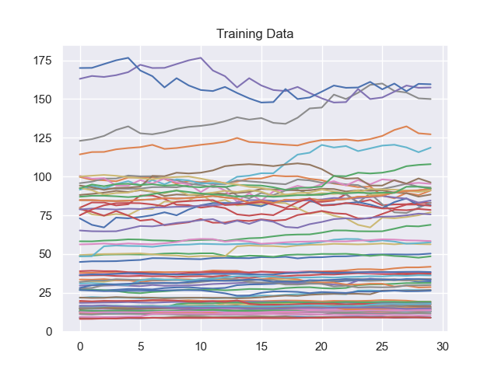
Experiment: Single Stock (AMZN)

Slide 41
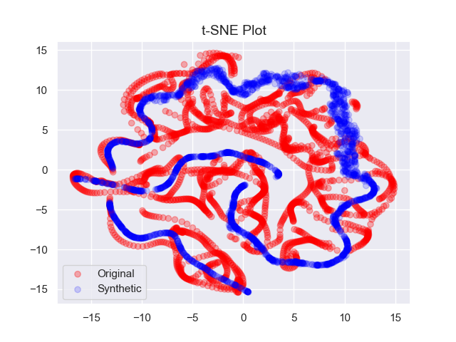
Experiment: Single Stock (GME)
)

Slide 42
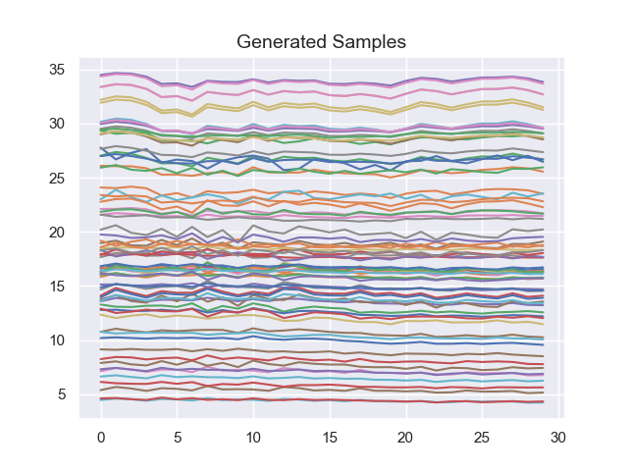
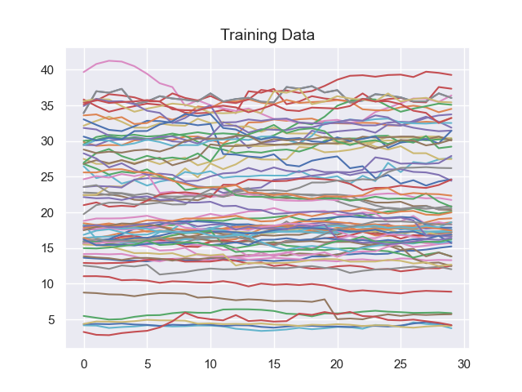
Experiment: Single Stock (GME)

Slide 43
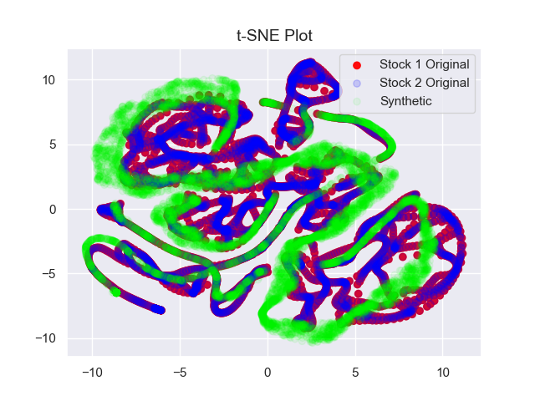
Experiment: Oracle Model (GME+AMZN)

Slide 44
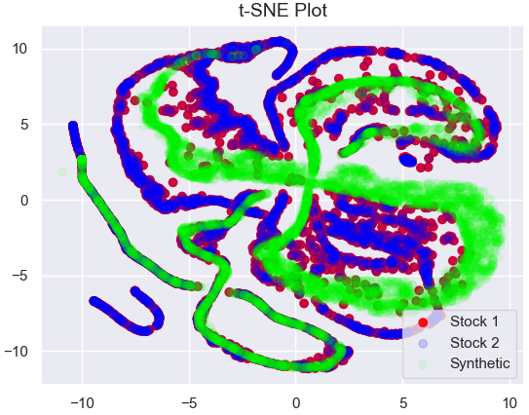
Experiment: Oracle Model vs. Synthetic Model
Oracle Model
Synthetic Model

Slide 45
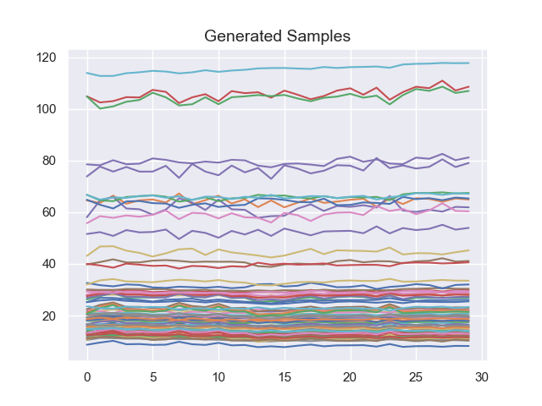
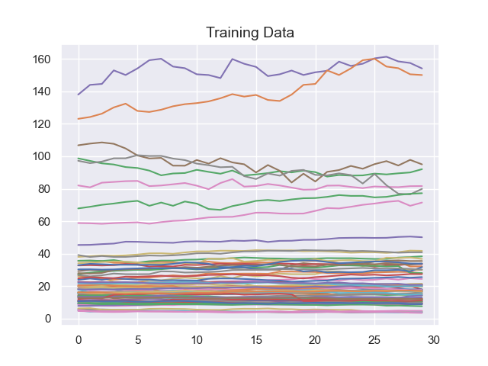
Experiment: Oracle Model (GME+AMZN)
Price
Price
Day
Day

Slide 46


Experiment: Synthetic Model (AMZN+GME)
Price
Price
Day
Day

Slide 47

Experiment: Transfer Model (GME->AMZN)

Slide 48


Experiment: Transfer Model (GME->AMZN)

Slide 49

Experiment: Transfer Model (AMZN->GME)

Slide 50


Experiment: Transfer Model (AMZN->GME)

Slide 51
Conclusion and Next Steps
Summary:
Demonstrated training VAE models on original and synthetic datasets comprising data from similar but distinct distributions; poor latent space structure
Compared performance with transfer learning
Demonstrated the advantage of using manifold regularization to preserve the latent space structure of the individual models
Next Steps:
Compare the quality of generated data from each of the experiments using quantitative metrics (ex: FID Score)
Compare different graph construction methods (computational costs)
Time series data: extend this experiment to time series data (stock prices); find similar distributions

Slide 52
References
Desai, A., Freeman, C., Wang, Z., & Beaver, I.. (2021). TimeVAE: A Variational Auto-Encoder for Multivariate Time Series Generation.
Jin, X.-B.; Gong, W.-T.; Kong, J.-L.; Bai, Y.-T.; Su, T.-L. PFVAE: A Planar Flow-Based Variational Auto-Encoder Prediction Model for Time Series Data. Mathematics 2022, 10, 610.
Luke Melas-Kyriazi (2020): The Mathematical Foundations of Manifold Learning.

Slide 53
Thank you!
Any Questions?
soham.palande@jpmchase.com

Slide 54
Appendix

Slide 55
MNIST

Slide 56


Experiment 1
(0, 9)
(6, 4)

Slide 57


Experiment 1
(0, 9)
(6, 4)

Slide 58


Experiment 2: Original Data

Slide 59


Experiment 2: Synthetic Data

Slide 60


Experiment 3a: Transfer Learning

Slide 61


Experiment 3b: Transfer Learning

Slide 62


Experiment 4: Manifold Regularization

Slide 63
Stock Price Data

Slide 64

Experiment: Single Stock (AMZN)
Means of the Latent Space

Slide 65

Experiment: Single Stock (AMZN)

Slide 66

Experiment: Single Stock (GME)
)
Means of the Latent Space

Slide 67

Experiment: Single Stock (GME)

Slide 68

Experiment: Oracle Model (GME+AMZN)
Means of the Latent Space

Slide 69

Experiment: Oracle Model (GME+AMZN)

Slide 70

Experiment: Transfer Model (GME->AMZN)
Means of the Latent Space

Slide 71

Experiment: Transfer Model (GME->AMZN)

Slide 72

Experiment: Transfer Model (AMZN->GME)
Means of the Latent Space

Slide 73

Experiment: Transfer Model (AMZN->GME)

Slide 74

Experiment: Synthetic Model (AMZN+GME)
Means of the Latent Space

Slide 75

Experiment: Synthetic Model (AMZN+GME)

